Slide 1
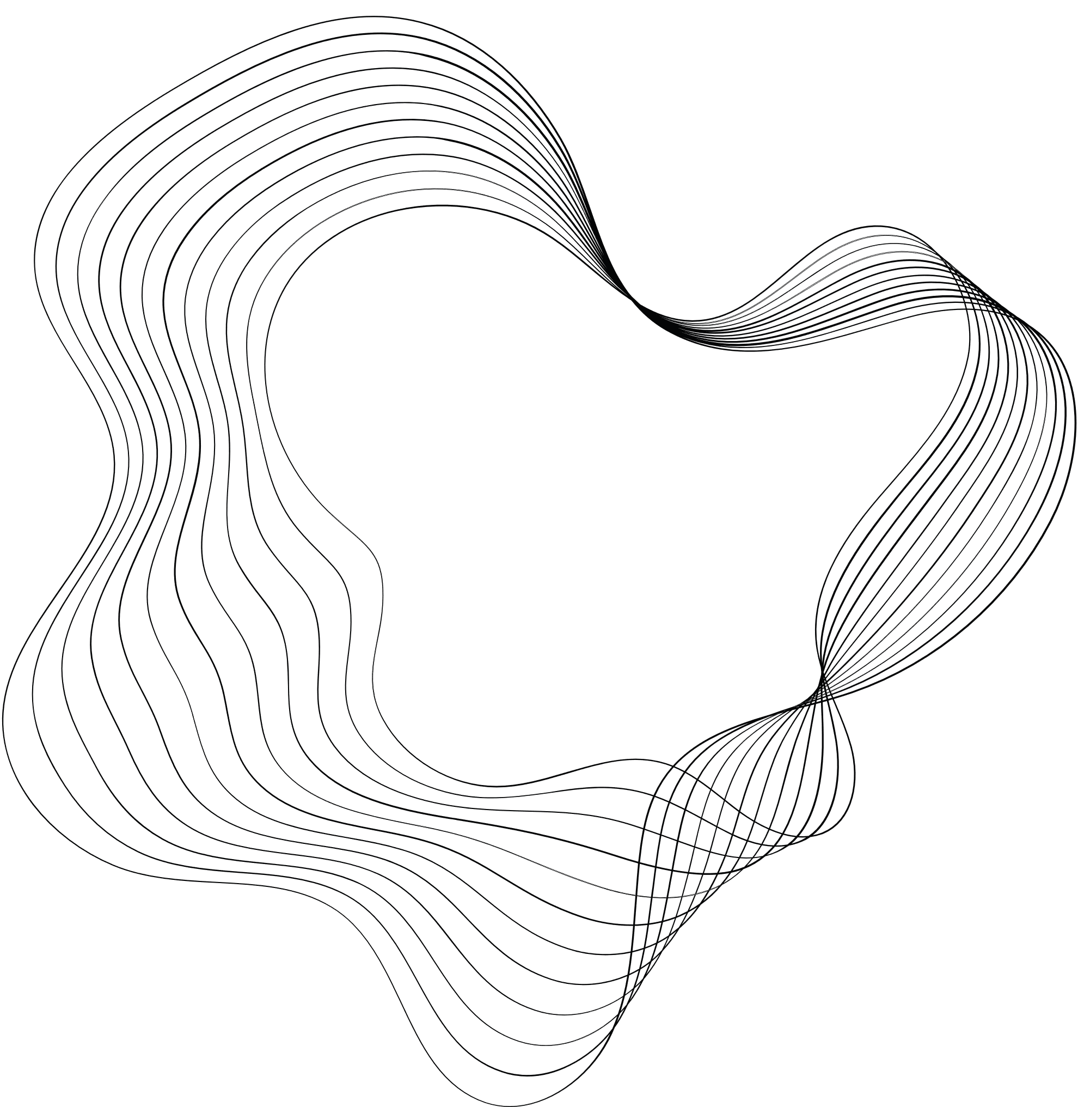

PREDICTING CREDIT RISK DEFAULTERS USING RANDOM FOREST
TUSHAR KHADANGLE

Slide 2
WORKFLOW
PROBLEM STATEMENT
A mid-sized bank aims to identify customers who are likely to default on their loans within the next 6 months. Additionally, the bank wants to segment its customers for targeted marketing. The bank has provided customer data, including loan information, transaction history, and account details.
As an intern at NeoStats, you will analyse the data to answer specific business questions, create insights, and build a predictive model. The focus here is on your ability to reason through data and derive meaningful conclusions.

Slide 3


Content
01
DATA OVERVIEW
02
DATA CLEANING
03
CUSTOMER DEMOGRAPHIC ANALYTICS
04
TRANSACTION AND BALANCE ANALYSIS
05
BEHAVIOURIAL INSIGHTS
06
DATA UNDERSTANDING
07
MODEL BUILDING
08
RECOMMENDATIONS

Slide 4
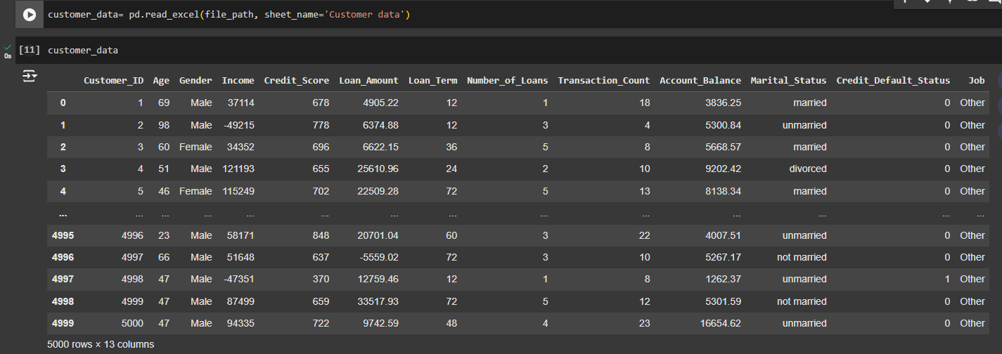


DATA OVERVIEW

Slide 5
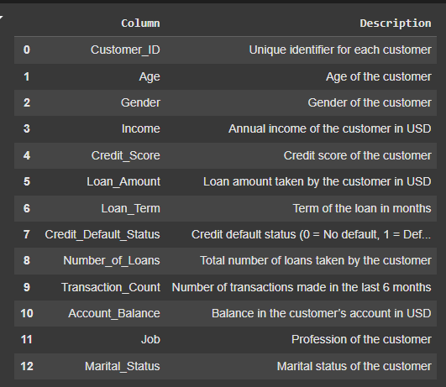
COLUMN DESCRIPTION

Slide 6
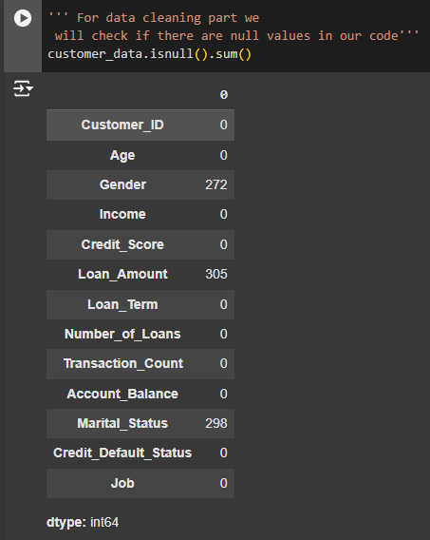


DATA CLEANING
Handling Negative Values:
Income: Replaced negative values with median income since negative income is unrealistic for the dataset.
Loan Amount: Replaced negative loan amounts with the median loan amount as negative loan amounts are not feasible.
Handling Zeros:
Transaction Count: Left zero values as they may indicate customers with no transactions in the last 6 months, which is meaningful for the analysis.

Slide 7
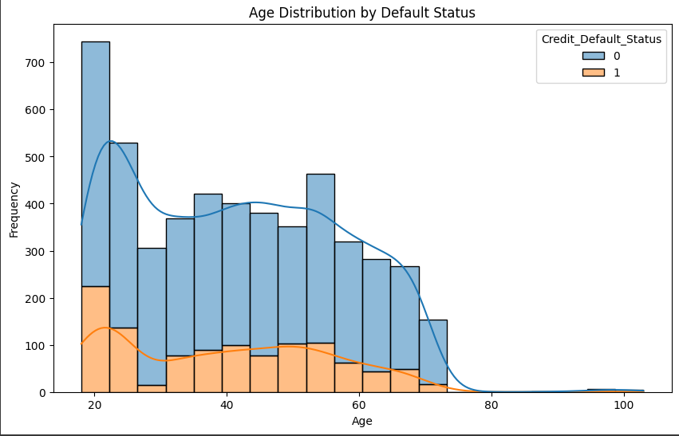


CUSTOMER DEMOGRAPHIC ANALYTICS
Age:
Defaulters: Mostly younger (18–30 years), likely due to less financial stability.
Non-Defaulters: Predominantly in the 30–40 range (financial maturity) and 60–80 range (responsible debt management).

Slide 8
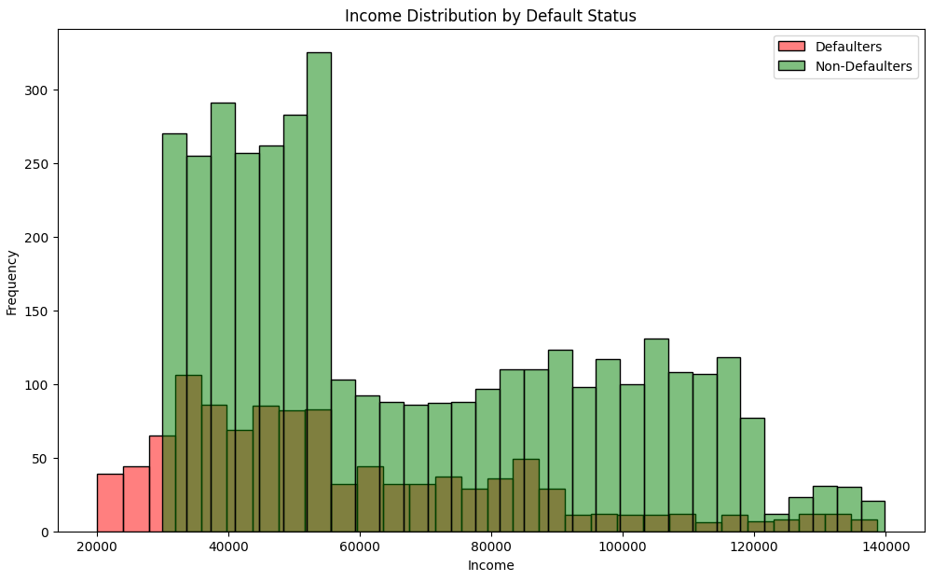
Income:
Defaulters: Concentrated in the lowest income group, indicating limited financial capacity to manage debt.
Non-Defaulters: Higher mean income, reflecting stronger financial capability to service loans.

Slide 9
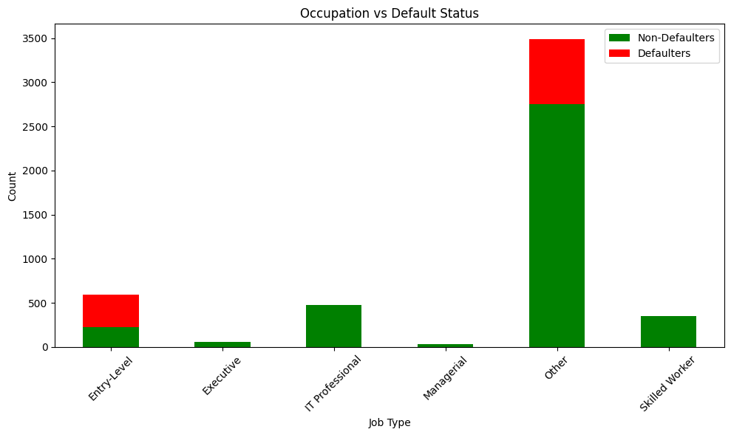
Occupation:
Defaulters: Frequently in uncertain jobs (freelancers, entry-level roles, etc.).
Non-Defaulters: More stable salaried positions, ensuring predictable income and better repayment ability.

Slide 10
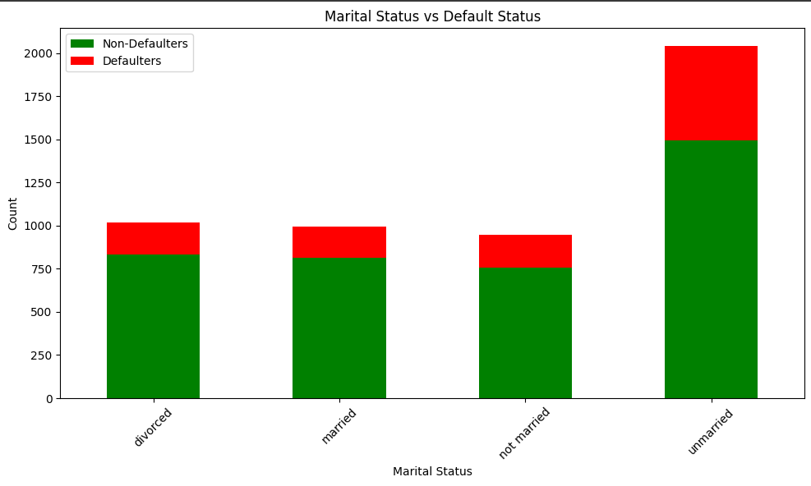
Marital Status:
Defaulters: More common among unmarried or divorced individuals, possibly due to single-income households or financial strain from divorce.
Non-Defaulters: Predominantly married, benefiting from dual incomes or structured financial planning.

Slide 11

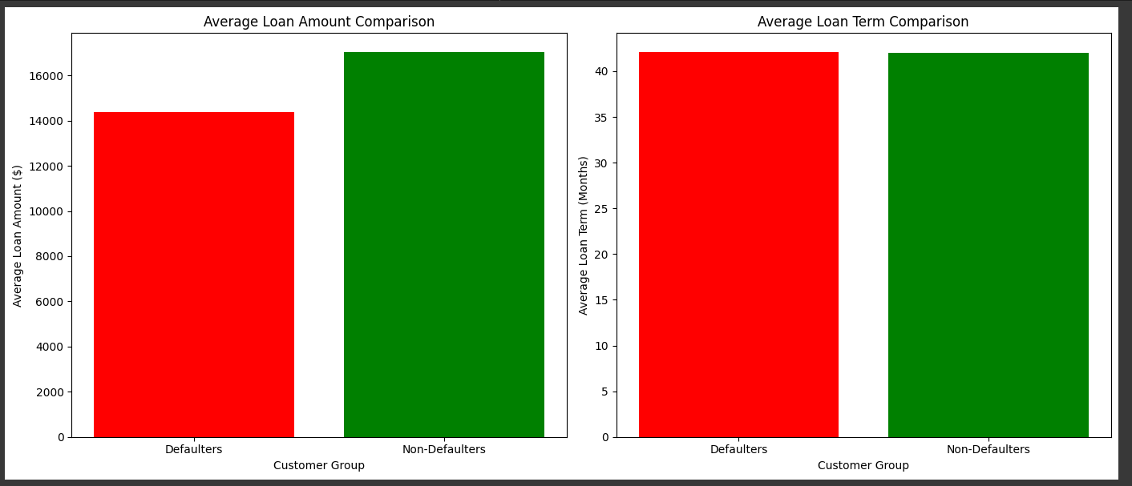
AVERAGE LOAN AMOUNT AND TERM FOR CUSTOMERS WHO DEFAULT
Average Loan Amount:
Non-defaulters take higher loan amounts, indicating better financial stability.
Defaulters tend to take smaller loans, possibly reflecting financial stress.
Average Loan Term:
The average loan term (~42 months) is similar for both groups, suggesting it has minimal impact on defaults.
Loan size plays a more critical role in predicting defaults.

Slide 12
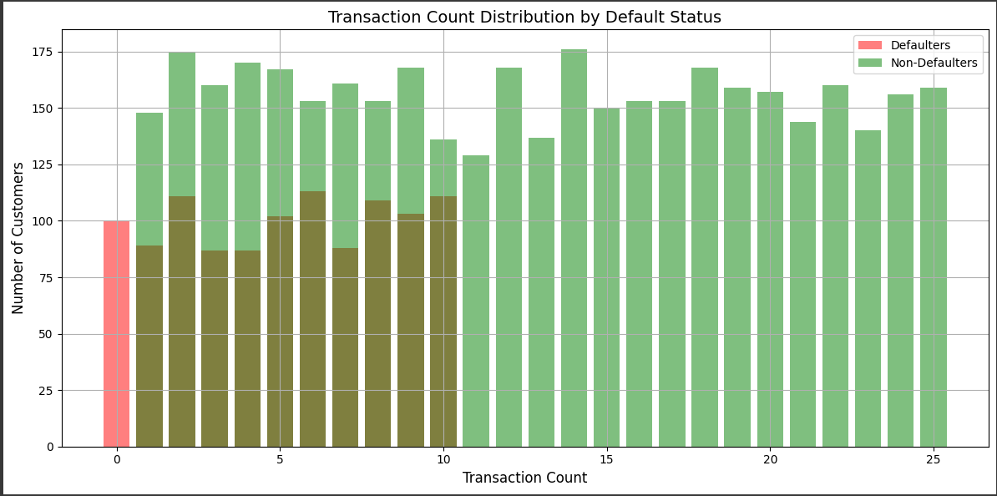
TRANSACTION AND BALANCE ANALYSIS
Transaction Count:
Defaulters tend to have lower transaction counts than non-defaulters.
Indicates that lower transaction activity may be linked to a higher chance of default.

Slide 13
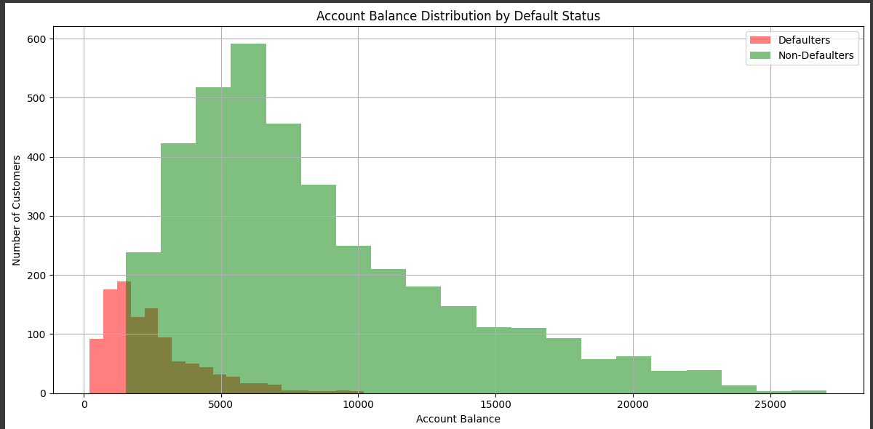
Account Balance:
Defaulters generally have lower account balances than non-defaulters.
Higher account balances may reflect better financial stability, reducing the likelihood of loan default.

Slide 14
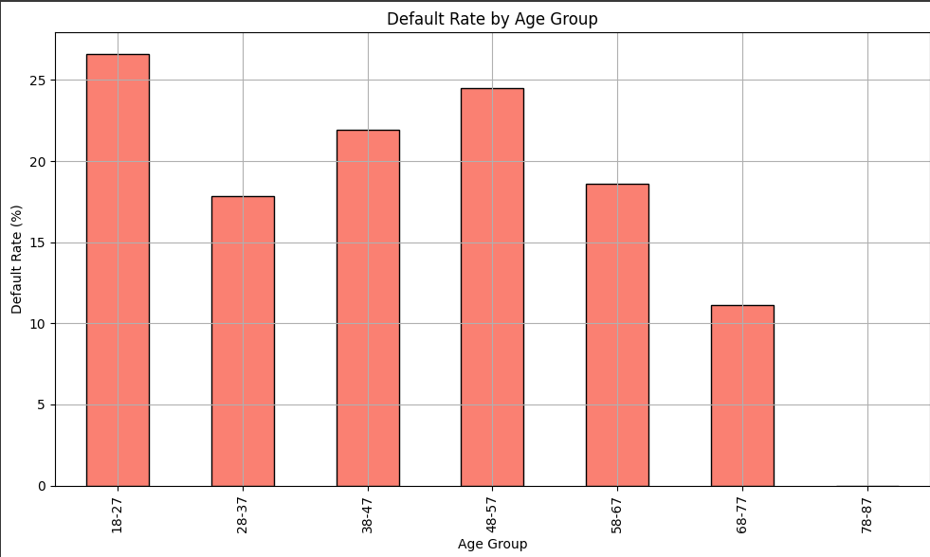
BEHAVIOURIAL INSIGHTS
Age Group:
Younger individuals face higher default rates due to limited financial history and lower income levels.
Older age groups are generally more financially stable, with lower default rates.

Slide 15
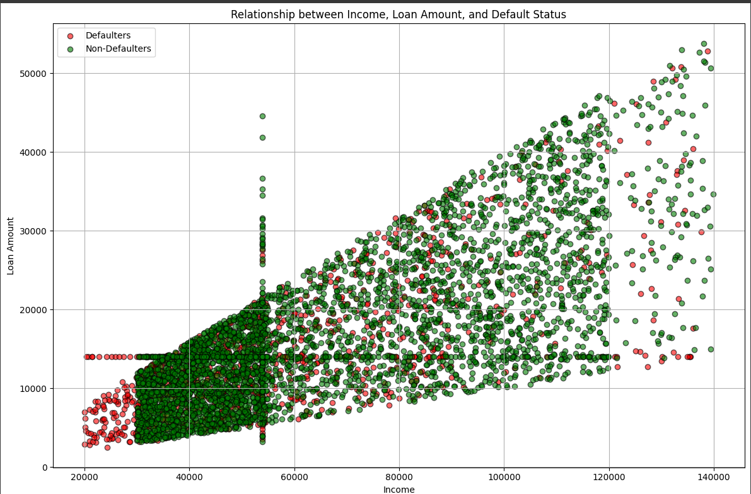
Income and Loan amount :
Individuals with lower incomes are more likely to default.
Higher default risk is observed when loan amounts are significant relative to income.

Slide 16

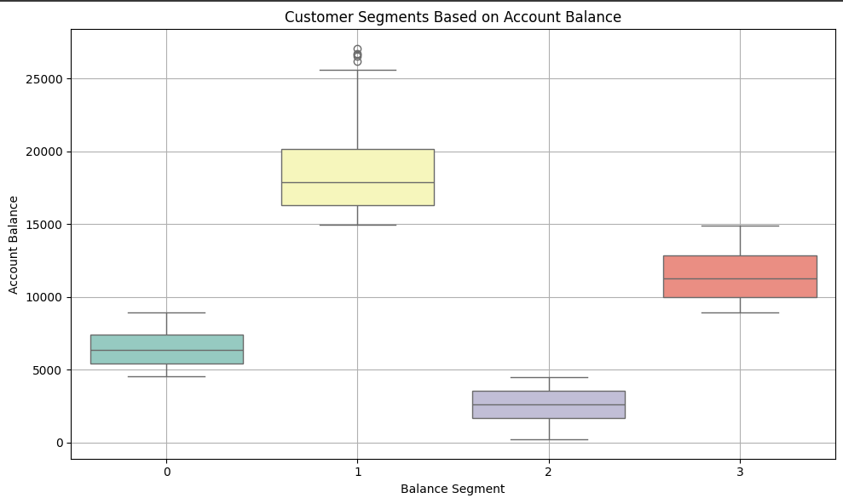
DATA UNDERSTANDING
Segment 1 (High): 475 customers, avg. balance $18,417.54 → Wealth management, premium services.
Segment 2 (Upper-Middle): 906 customers, avg. balance $11,484.24 → Premium savings plans, auto loans.
Segment 3 (Moderate): 1,848 customers, avg. balance $6,465.39 → Mid-tier loans or credit cards.
Segment 4 (Low): 1,771 customers, avg. balance $2,587.65 → Microloans, financial education.

Slide 17
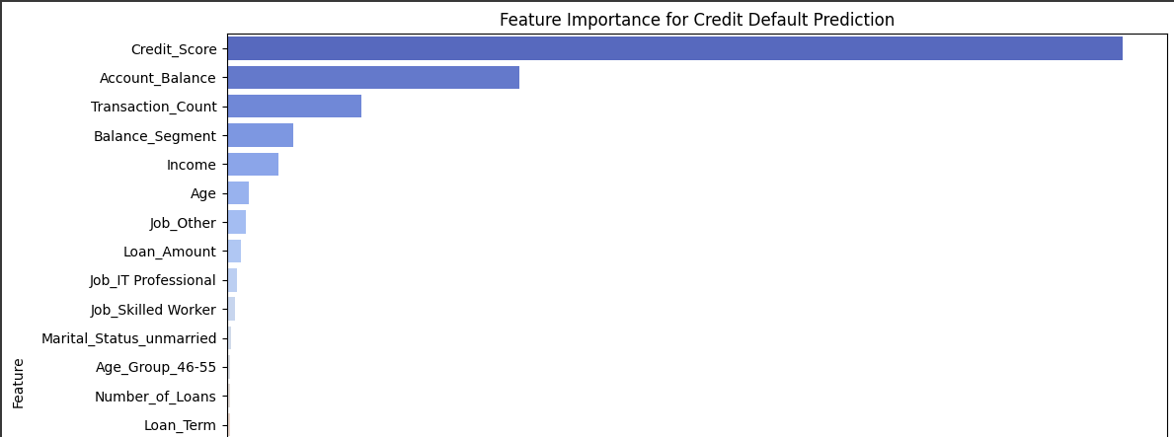
Credit Score:
Most important feature for predicting credit default risk.
Reflects financial health and creditworthiness.
Higher credit score = lower default risk.
Transaction Count:
Reflects customer engagement with financial products.
Higher transaction activity is linked with lower default risk.
Balance Segment:
Further refines prediction by segmenting customers based on account balance.
Customers with higher balances are less likely to default.
Account Balance:
Key indicator of financial stability.
Higher balances suggest better ability to manage debt, reducing default risk.

Slide 18

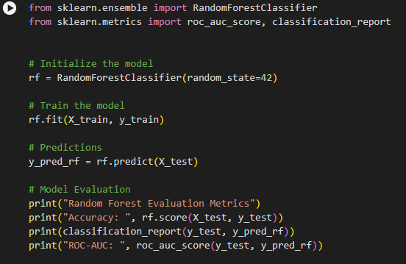
PREDICTIVE MODELLING
Ensemble Learning:
Random Forest uses ensemble learning, combining multiple decision trees to improve model accuracy and reduce overfitting.
Decision Trees:
Random Forest builds multiple decision trees on random subsets of data, ensuring diverse decision boundaries and robust predictions.
Handling Overfitting:
Random Forest mitigates overfitting by aggregating predictions from multiple trees, making it more generalizable to unseen data.
Prediction Averaging:
The model makes predictions by averaging the outputs of all decision trees, improving accuracy and stability compared to individual decision trees.

Slide 19
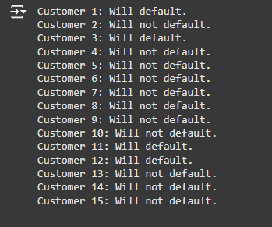
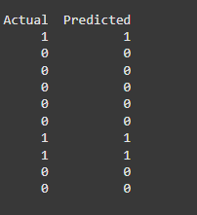
High Accuracy (99%):
Demonstrates the model’s ability to effectively predict both defaulters and non-defaulters.
Generalization to Unseen Data:
Successfully predicted new customer profiles, showing the model is not overfitting.
Identifying Key Patterns:
The model identifies crucial patterns that correlate with loan defaults, providing valuable insights.
Class Imbalance Handling:
Despite class imbalance, the model effectively predicts the minority class (defaulters), vital for risk management.
Practical Application:
The model can confidently be used for identifying high-risk customers and assisting in loan approval decisions (e.g., adjusting loan terms).

Slide 20
RECOMMENDATIONS
Targeted Loan Offerings
Income and Loan Size Adjustment
Age and Job Type Consideration
Loan Terms and Monitoring
Incentivize Financial Engagement
Customer Segmentation and Personalized Marketing
Debt Restructuring for Defaulters

Slide 21
HOPING TO SEE YOU SOON IN THE OFFICE !
THANK YOU

